Slide 1


coredataengineers
SQL:
The journey starts here……..
BY QUDUS AYOOLA

Slide 2




ABOUT ME
Introduction
I am a Data Engineer with 4+ years hands-on experience building and maintaining scalable and reliable data pipelines that ingest/process data at scale and enable better, data-informed decision and provide actionable insight. I have experience in the field of Data Analytics, ETL Development, Data Quality and Master Data Management, Data Modeling, Enterprise Datawarehouse Design and Technical Architecture Design.
Facilitator
Qudus_ayoola_
Qudus Ayoola

Slide 3
Table Of Content
Content List
01.
02.
03.
Data Fundamental: Databases and Data warehousing
Downloading the postgres server locally
Basic Queries
04.
05.
06.
SQL Data Cleaning
SQL Window Functions
Introduction to Advanced SQL (Subquery & CTE)
07.
08.
09.
SQL DDL, DML commands
Creating Tables/Views (working with tables)
Stored Procedures
10.
Entity Relationships Diagrams

Slide 4

coredataengineers
Introduction?
Data is now easier to collect and cheaper to store, making it accessible to nearly every business.
Every business would like to grow their revenues and make larger profits. Using data, organizations can address important challenges and opportunities.
When analyzed properly, data provides a wealth of useful information and inform critical business decisions.

Slide 5

coredataengineers
What is Data?
Data is everything. Examples: name, location, quantity, amount, height, time temperate, brightness, metadata, e.t.c.
The goals of analyzing data is to help a person or organization make objective decision that will most likely yield the desired outcome.

Slide 6

Why is Data Important?
It provides KPIs, spot trend.
To predict future sales and purchasing behavior.
To help and protect against fraud
To boost customer acquisition and retention.
It increases efficiency.

Slide 7
coredataengineers
Data formats?
Structured data
Semi-structured data
Unstructured data

Slide 8
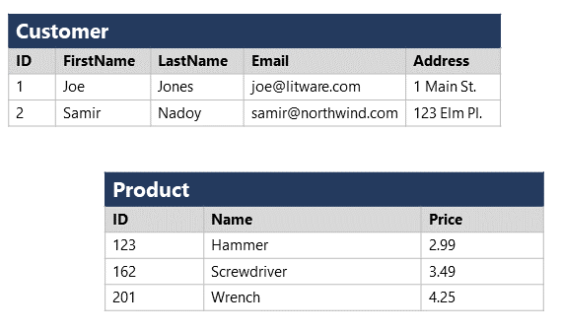
Data formats?
01.
02.
Unstructured Data
Structured Data
Semi-
Structured Data
03.
Data organized in rows and columns. It adheres to a fixed schema, so all of the data has consistent properties. It is well organized and accurately formatted
Examples: Relational database, CSV files, Excel files.
Not all data is structured or even semi-structured.
For example, documents, images, audio and video data might not have a specific structure.
Data with some degree of organization. It still has some structure to it but doesn’t adhere to a fixed schema.
Examples: Hypertext Markup Language(HTML) files, JavaScript Object Notation(JSON) files.

Slide 9


Data Storage and management
File Storage
Data Warehouse
Delimited text files(CSV).
JavaScript Object Notation (JSON).
Extensible Markup Language (XML)
It is a central repository of information that can be analyzed to make more informed decisions.
It is a data management system optimized to support business activities
Eg Redshift, Azure Synapse, Snowflake
Database
Data Lakes
Database is an organized collection of structured data.
Data in databases is stored in tables that can be thought of just like Excel spreadsheets.
Database columns are consistent
Eg Postgres DB, MySQL, SQL Server DB
A data lake is a centralized repository designed to store, process, and secure large amounts of structured, semi-structured, and unstructured data
Eg S3 bucket, Azure Blob Storage, GCS

Slide 10

coredataengineers
Why Choose Database?
It store tables with rows and column with unique name
It allows integrity.
Many people can access concurrently.
Data can be access quickly.
It can store large amount of data

Slide 11
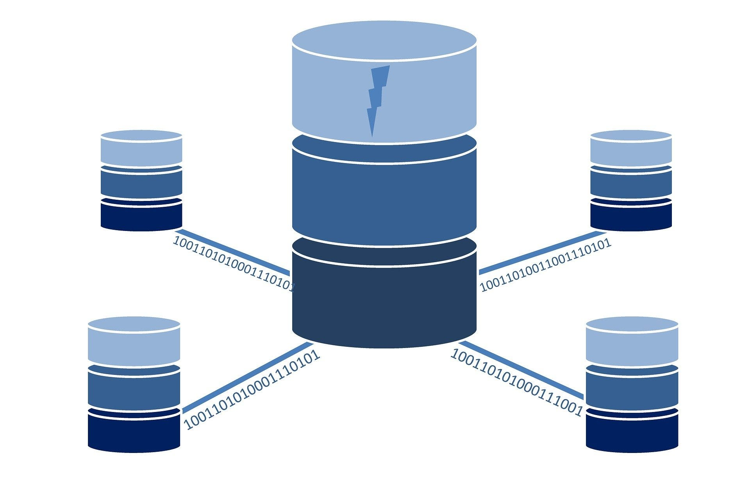
coredataengineers
What is SQL?
SQL means Structured Query Language.
SQL language is used to interact between tables in a DB.
It can query a table or multiple tables in a database.

Slide 12
coredataengineers
Why SQL?
A lot of data sits in database
Easy to understand
Access data directly
Run query on multiple table

Slide 13
Statements in SQL?
Statements tell the database what you’d like to do with the data
01.
02.
DROP
SELECT
CREATE
03.
It allows you to read data and display it. This is called a query
The SELECT statement is the common statement used by analysts
It is a statement that creates a new table in a database.
The CREATE statement is the common statement used by analysts
DROP TABLE is a statement that removes a table in a database.

Slide 14
coredataengineers
Statements in SQL?
A lot of data sits in database
Easy to understand
Access data directly
Run query on multiple table

Slide 15
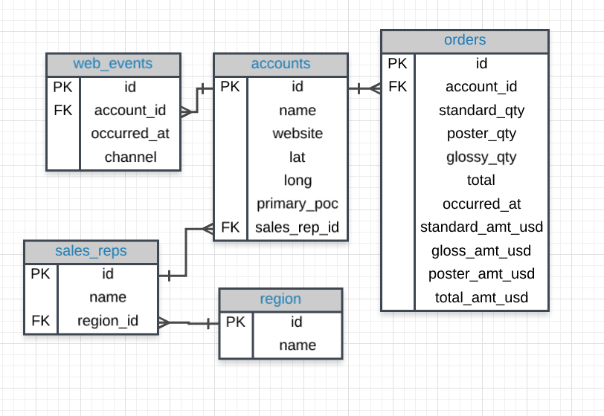
coredataengineers
ERD?
Entity Relationship Diagram is used to visualize relationship between tables in databases.
For this session we will focus on Parch and Posey data. Parch and Posey is a company that sells paper across the 4 regions in the united state with 50 sales reps. It isn’t a real company but a simulation.

Slide 16

THANK YOU
Let’s take a deep dive into SQL.

